Slide 1
Project 2
Analysis to Identify The Best-Performing Product and Customer segment at Superstore using
SQL and Excel

Slide 2
Background Information
Problem Statement : Which product category and which customer segment are the best-performers and why?
Goal : To identify the best-performing product category and customer segment.
Intended Audience : The Regional Sales Director
Data Source : The Superstore database
Hypothesis : The number of sales and profit are the deciding
factors for the best performing product category and
customer segment.

Slide 3
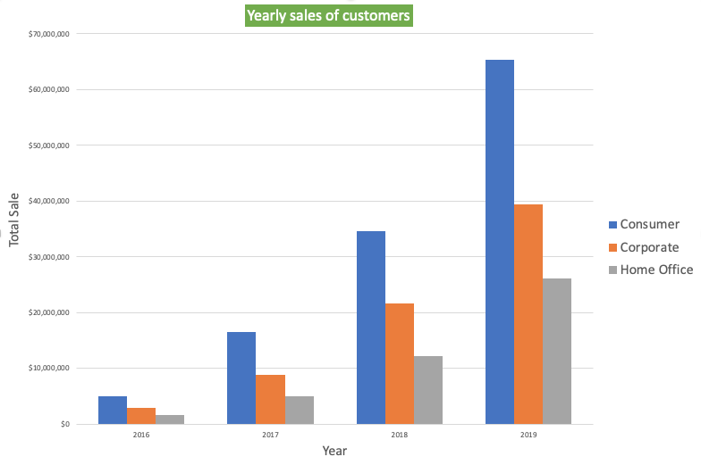
Total sales of customers from all the segment from year 2016 – 2019.
In 2016, the Consumer segment made more than 5 million.
In 2017, the Consumer segment made 16.6 million.
In 2018, the Consumer segment made 34.5 million.
In 2019, the Consumer segment made more than 65 million.
Overall, customers from ‘Consumer’ segment contributed the most in total sales followed by Corporate and Home Office.

Slide 4
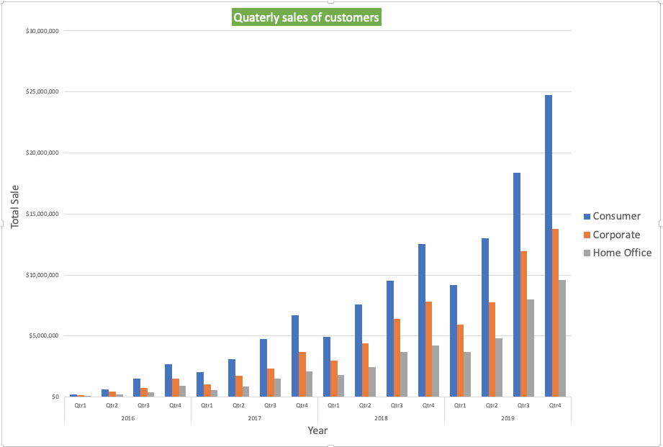
Breakdown of yearly sales into Quarters of all customer segments from year 2016 -2019
Breakdown analysis of yearly sales into the four quarters shows that :
Quarter 1 had the lowest number of sales throughout the three customer segments in every year.
Quarter 2 had the second lowest number of sales throughout the three customer segments in every year followed by Quarter 3.
Quarter 4 had the highest number of sales throughout the three customer segments in every year.
The difference between the yearly sales in 2016 and 2019 is significantly high while Consumer segment remains the highest contributor for total sales.

Slide 5
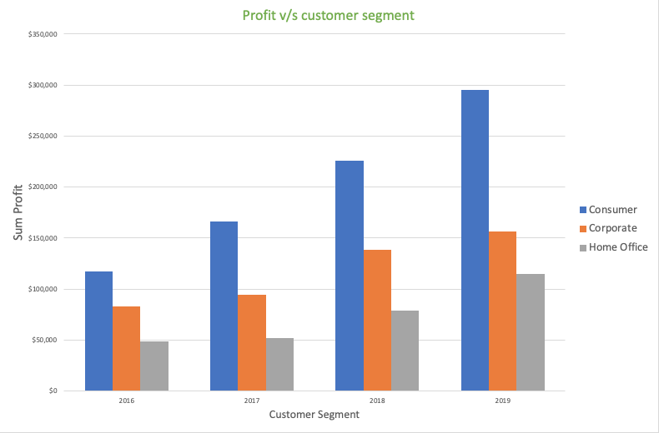
Best performing Customer segment based on profit (2016 – 2019)
Throughout 2016 – 2019, the Consumer segment made the highest amount of profit followed by Corporate and the least was made by Home Office.
The Home Office segment did not show much growth progression in the profit between year 2016 – 2018.
However, it showed significant growth in the profit in the year 2019, which was $114,495.
Similarly, in 2018, Corporate segment made a jump in the profit amount with a significant figure. As it made $94,177 in 2017 and $138,180 in 2018.

Slide 6
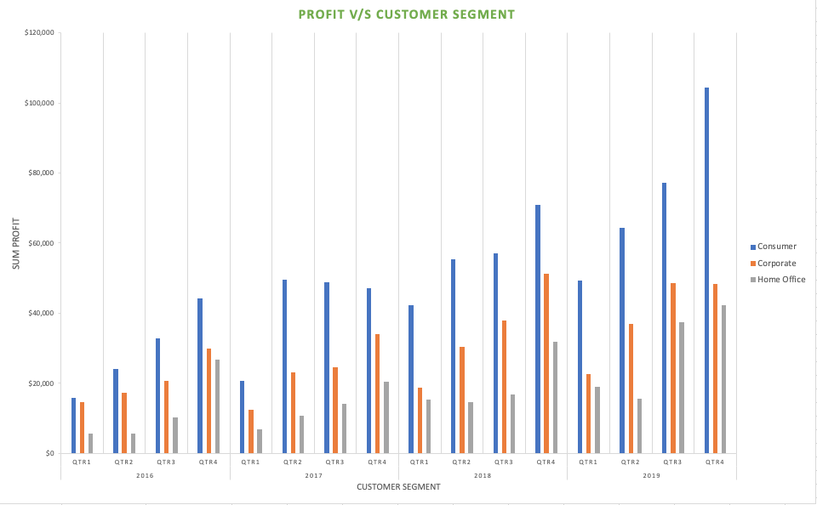
Breakdown analysis of profit made by all three customer segments
The Consumer segment was the most profitable in all the quarters of each year.
The Corporate segment made second highest number of profit in all the quarters of each year.
In 2019, the Home Office segment saw a small drop in the profit in 2nd quarter, but it picked up eventually in 3rd and 4th quarters.
Which makes Home Office as the segment that made the least amount of profit overall.

Slide 7
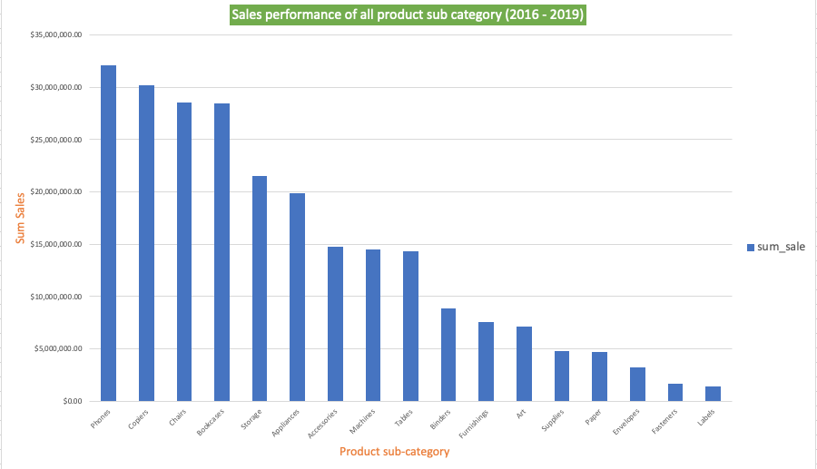
Overall sales performance of all product sub-category
Overall, the Phones were the highest selling product sub-category with over $ 32 million.
The second product sub-category was Copiers with over $ 30 million.
Followed by chairs and bookcases sub-categories. The difference between them was only $76,374.
The lowest selling sub-category was labels.

Slide 8
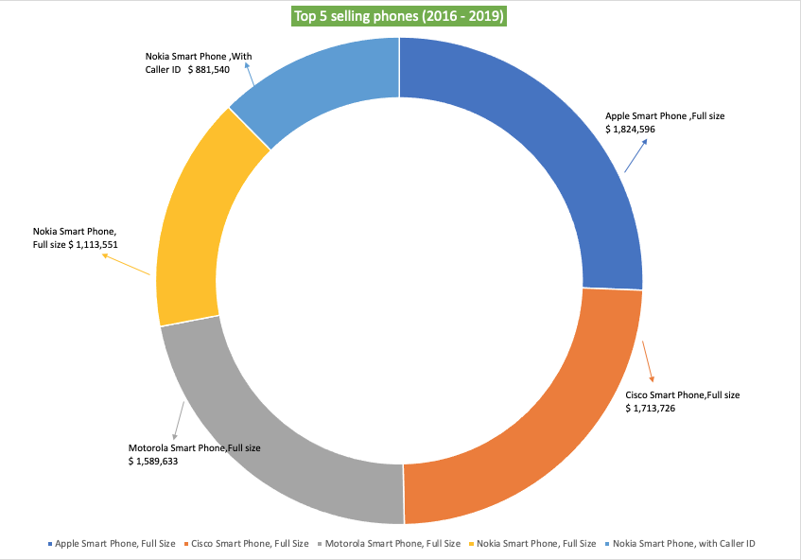
Top 5 selling phones (2016 – 2019)
Apple Smart phone, full size was the highest selling phone with $1.8 million.
Second was Cisco Smart phone, full size which made $1.7 million.
Followed by Motorola Smart Phone ($ 1.5 million), Nokia Smart Phone ($1.1 million) and Nokia Smart Phone, with Caller ID ( $ 881,540).

Slide 9
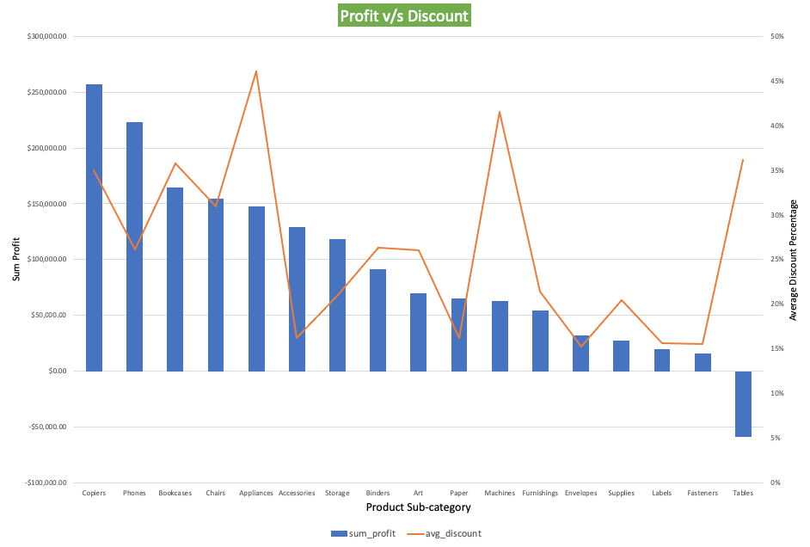
Analysis of most profitable product sub-category between year 2016 -2019
The Copiers made the most profit out of all the product sub-categories.
It made $257,314 profit with average discount of 35%.
While the Phones was the second most profitable product sub-category. It made $223,043 with average discount lesser than the Copiers sub-category (26%).
Although the highest average discount was given on Appliances, 46% which was the maximum, it could only return the profit amount of $ 129,314.
While Tables sub-category made a loss amount of $59,101 even though the average discount provided was 36%.

Slide 10
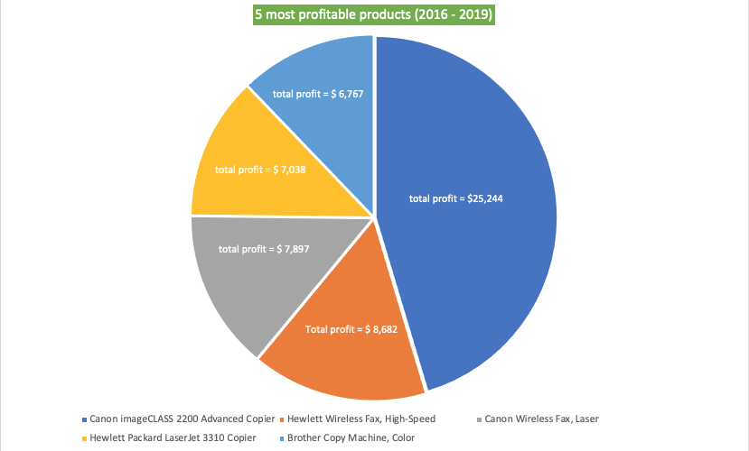
5 most profitable product from ‘Copiers’ sub-category (2016 -2019)
Overall, the Canon image CLASS 2200 Advanced copier was the best performer out of all the Copiers sub-category with a huge margin, making $25,244 of total profit.
Second was Hewlett Wireless fax, High-Speed, which made $ 8,682 of total profit.
Followed by Canon Wireless Fax, Laser, Hewlett Packard Laser Jet 3310 Copier and Brother Copy Machine, Color.

Slide 11
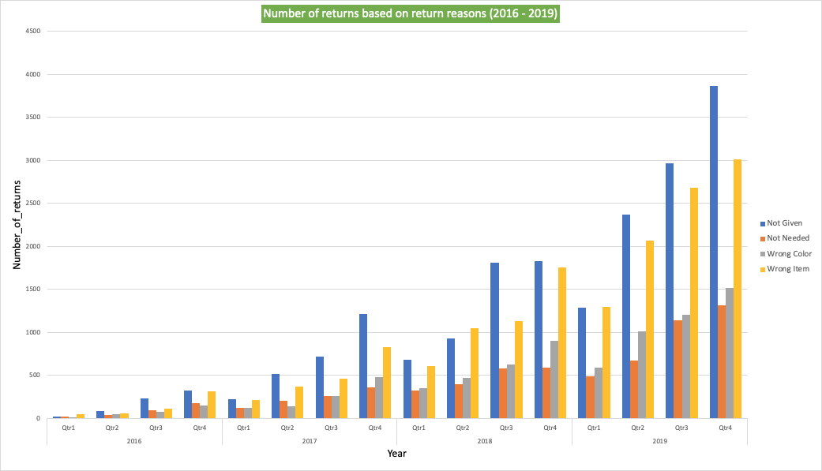
Quarterly breakdown of total number of returns based on return reason between year 2016 - 2019
In almost all the years, Quarter 4 had the greatest number of returns, specially 2019.
The return reason for the maximum returns was ‘Not Given’ throughout the year.
The second most common return reason was ‘Wrong Item’ and throughout the year, which reflects a negligence in the packing department.

Slide 12
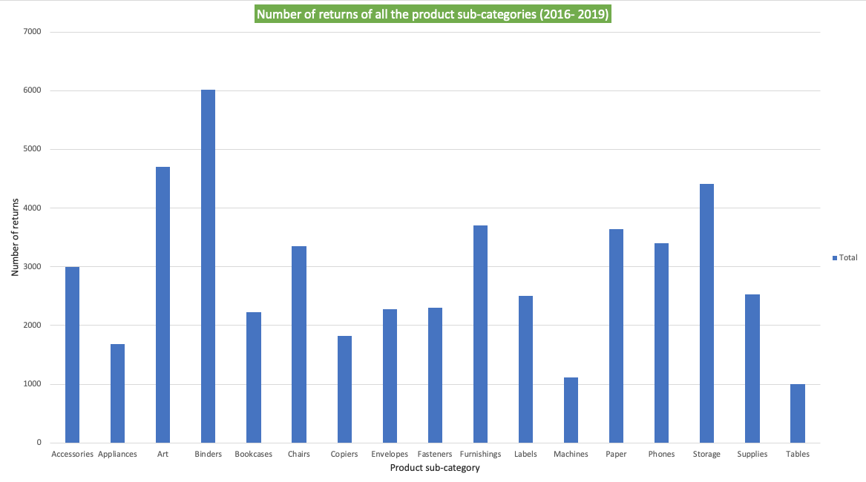
Number of returns made by all product sub-category (2016 – 2019)
Maximum returns were from the Binders category in which ‘Cardinal Binding Machine, Clear was the most returned item.
Tables sub-category had the lowest number of returns.
Also, each returned sub-category had the maximum return reason as ‘Not Given’ (supported by pivot table in the excel).
Therefore, it is recommended that more options for return reason to be added.

Slide 13

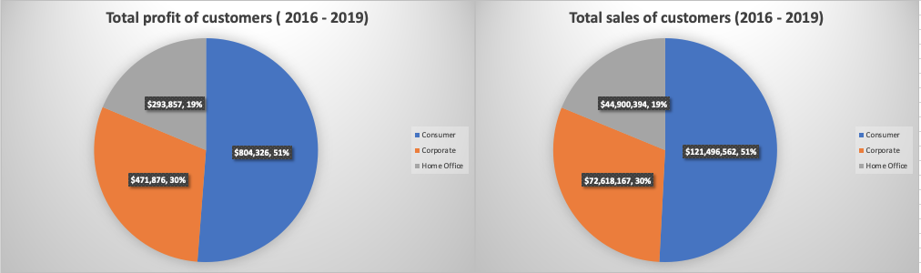
Conclusion
Based on total sales and total profit made from the year 2016 – 2019, ‘Consumer’ segment is the best performing customer segment out of the three segments.
It made the total sales of $121,496,562 and total profit of $804,326.

Slide 14

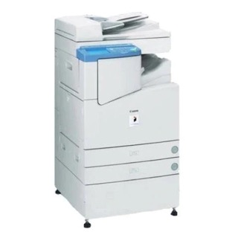
Conclusion
Based on the total sales from year 2016 – 2019, the ‘Phones’ were the best performing product sub-category as it was the highest selling product sub-category with over $ 32 million. In which, Apple Smart phone, full size was the top contributor.
Based on the total profit made between year 2016 – 2019, the ‘Copiers’ were the best performing product sub-category as it made the highest amount of profit of $257,314 out of all the sub-categories.
In which, Canon image CLASS 2200 Advanced copier made the highest profit of $25,244.

Slide 15
Recommendations
Decrease the discount percentage during 4th quarter of the year to maximize the profit amount as it was the highest selling quarter throughout the year 2016 – 2019.
A further investigation is recommended for the ‘Tables’ sub-category as it suffered a significant loss of $59,101.
As the most common reason besides the reason ‘Not Given’ for return of the Tables was ‘Wrong Item’, it is recommended that a thorough investigation is to be made in packing department.
Same goes for all the product sub-category.
It is recommended to add another option like ‘Others – specify’ in the return reason in order to have an accurate reason for the returns.

Slide 16
Thank You

